Slide 1
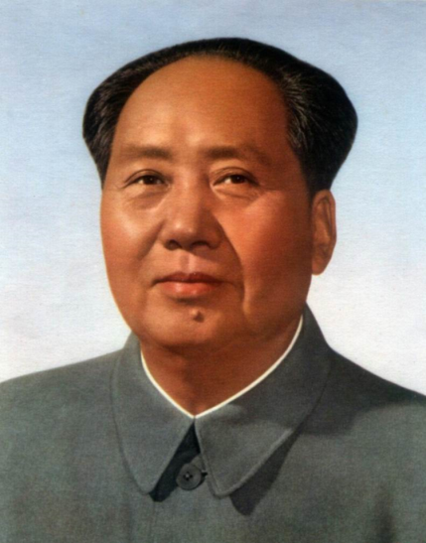
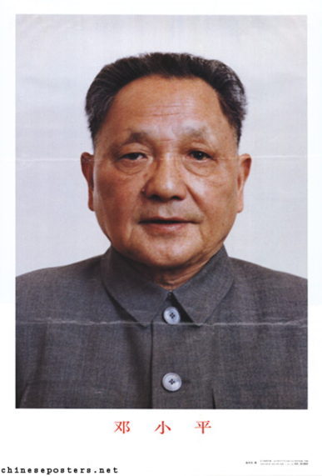
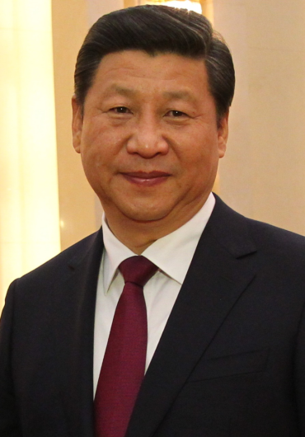
China Transforms its Economy (1)
From Communism (Centrally-Planned) disaster of Mao Zedong 1949-1976 to Capitalism (Market-Orientated) reforms 1978 onwards by Deng Xiaoping, and continued by today's leader, Xi Jinping.
Special Economic Zones (SEZs) in 1980s on the coast, originally facing Taiwan e.g. Shenzhen, Zhuhai, Shantou & Xiamen ... tax, tariff & investment incentives to attract TNCs.
Later more SEZs & city-based economic zones ('Open Cities') on the coast e.g. Shanghai (Pudong District), Tianjin & Zhanjiang...maintaining the inflow of Foreign Direct Investment (FDI).
FDI is the key to economic growth...$128 billion FDI in 2014 & GDP growth around 7-10% a year since early 1990s.

Slide 2
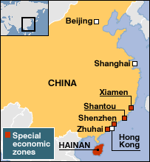
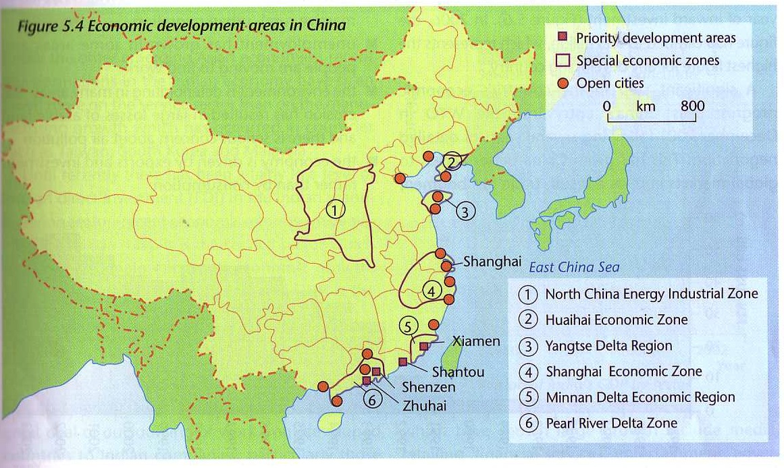
A Special Economic Zone (SEZ) is a geographical region that has economic and other laws that are more free-market-oriented than a country's typical or national law.
The original 4 SEZs - established in the early 1980s
SEZs, Open Cities and other priority development areas

Slide 3
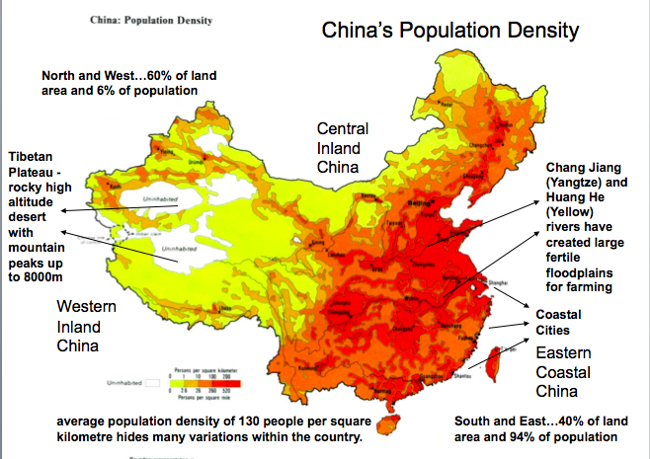
China in Numbers (2014)
Population: 1.37 billion
Population Growth Rate: 0.44%
Age Structure: 17% 0-14; 74% 15-64; 9% 65+
Urban Population: 55% Rural Population: 45%
Urbanisation Rate: 2.85%

Slide 4
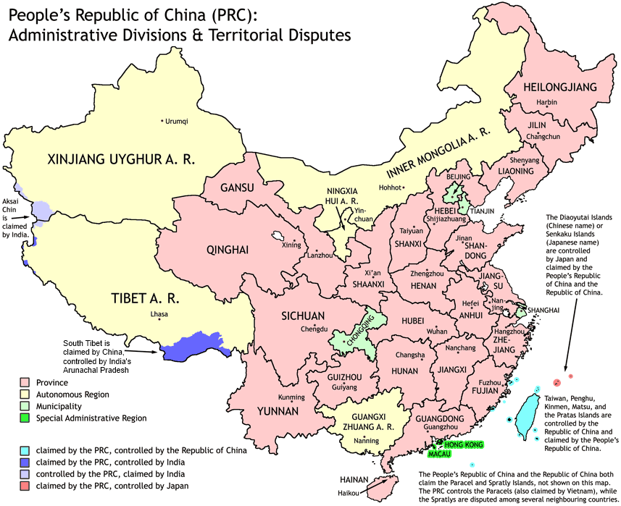
China in Numbers (2014)
Population: 1.37 billion
Labour Force: 802 million
Unemployment: 4.1%
Urban Pop: 55%
GDP: $10.37 trillion
GDP per capita: $7,400
GDP growth: 7.4%
HDI: 0.699
Inflation: 2%
Gov Debt: 15% of GDP
Exports: $2.34 trillion
Imports: $1.96 trillion
Trade Surplus of $380 billion

Slide 5
Attractions of China for Foreign Direct Investment
Cheap and plentiful labour force for semi-skilled work, with a hardworking mentality and limited restrictions on working hours.
Large scale, modern and well equipped manufacturing facilities, with the ability to upscale production very quickly to meet high demand.
Encouragement from a supportive government, with fewer regulations, easier acquisition of land and lower taxes. In the SEZs, tax levied at 15% on production-orientated foreign investment.
Rapidly improving infrastructure, due to the country’s huge investment in new roads, railways, ports, airports, telecommunications and electricity.
Direct access to an expanding domestic market, as well as close proximity to the rest of Asia, and access to the US via the Pacific Ocean shipping routes.
China’s dominant position in the global supply of rare earth metals, used in the telecommunications and consumer electronics industries.

Slide 6
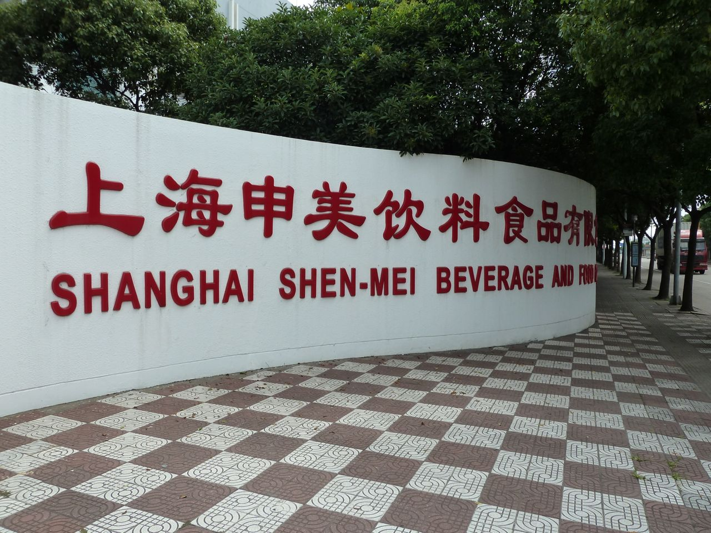
Coca-Cola returned to China in 1979, having been forced to leave during the Communist Revolution of 1949. By 2013, Coca-Cola had 43 plants in China, and a 16% share of China's $69 billion soft drinks market. The expansion of McDonald's in China is also helping Coca-Cola.

Slide 7
China is a key manufacturing base for Apple, and a rapidly growing market for Apple's products. Apple outsources final assembly of iPhones iPads and MacBooks to Taiwanese-owned companies, such as Foxconn and Pegatron. China accounts for at least 15% of Apple's global sales, and iPhone sales in China exceed sales in the USA. There were 19 Apple Stores in China in early 2015.

Slide 8
China Transforms its Economy (2)
China now has the 2nd largest economy in the world - $10.37 trillion in 2014. Per capita GDP has increased every year since 1979, reaching $7,400 in 2014.
Massive investment in new roads, railways, airports and telecommunications has created a world-class infrastructure.
More than 50% of China's exports are linked to Foreign Direct Investment (FDI). It has become the 'factory to the world'.
China's entry into the World Trade Organisation (WTO) in 2001 has given the country better access to global markets.
Trade boomed from $266 billion of exports in 2001 to $2.34 trillion of exports in 2014 (with a trade surplus of $380 billion).

Slide 9
China Transforms its Economy (3)
‘Ladder Step' Policy...regions are equated to steps on a ladder and the coastal region has been made internationally competitive first, with other regions soon to follow as investment moves inland.
3 Major Global Hubs in the Core Region along the East Coast:
Beijing – capital city, largest software production centre, Olympic
city, transformed from an industrial to a service economy
Shanghai – commercial and financial centre, industries including
steel, autos and semiconductors
Guangdong Province (incl. Hong Kong and Guangzhou) – industries including toys, shoes, appliances and electronics
Resource Frontiers...The Three Gorges Dam in Hubei province and major oil and gas fields inland have provided opportunities for further economic growth, much of it in the poorer interior.

Slide 10
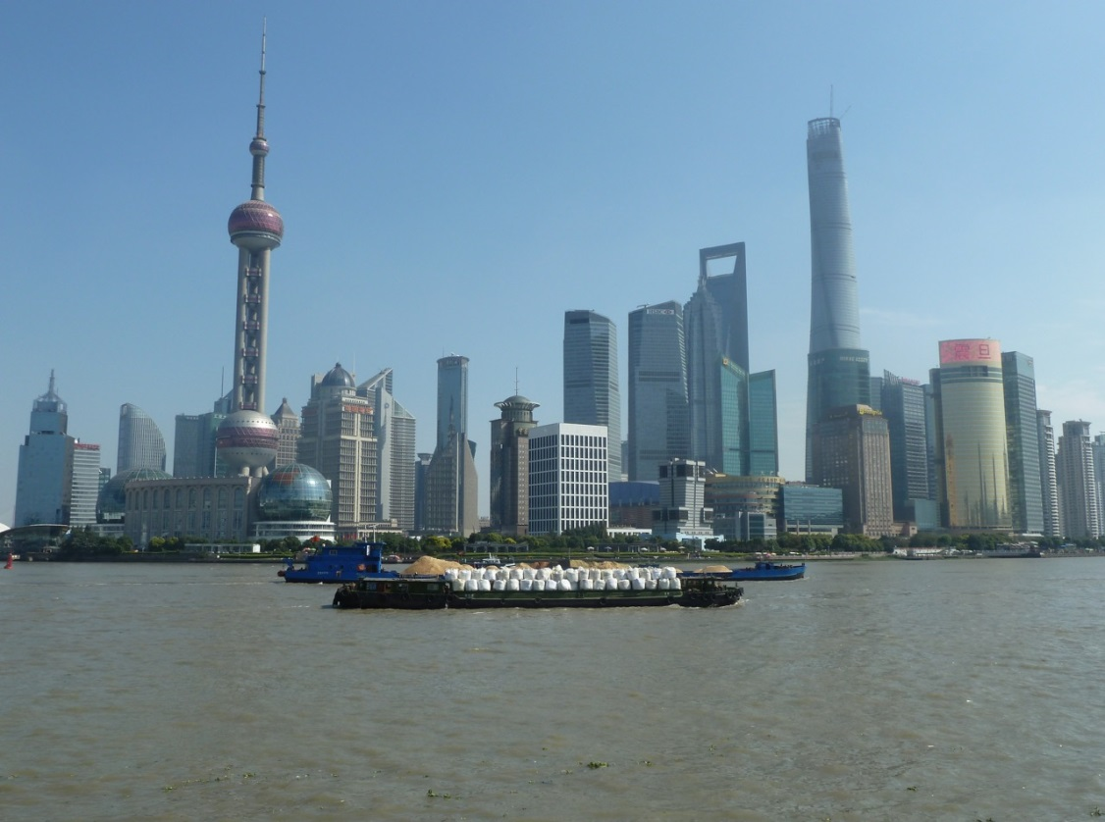
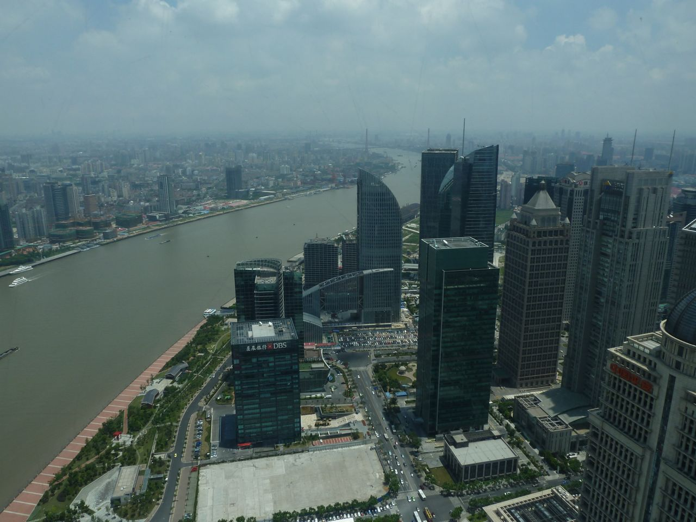
Shanghai
21 million people live in Shanghai. The Shanghai region is responsible for 30% of China’s exports, it has attracted 25% of the FDI in China, and is producing 20% of China’s manufactured goods.
Shanghai is China's key global city. It is home to the world's busiest container port, as well as 800 financial institutions and the Shanghai Stock Exchange. The city's Pudong District is inside an SEZ, and includes the Oriental Pearl Tower, Shanghai World Financial Center and the Shanghai Tower (632m at a cost of $2 billion+)

Slide 11
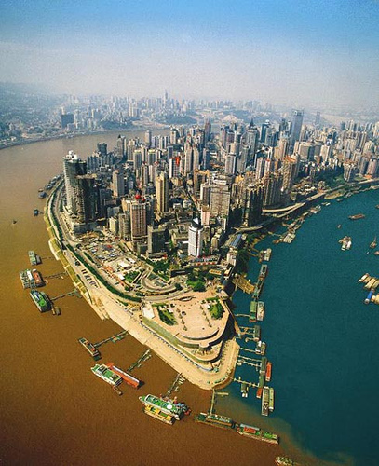
Chongqing
Chongqing is China’s largest inland port, and a key city in the country’s ‘Go West’ policy. The city benefits from the electricity generated by the Three Gorges Dam. Heavy Industries have played a major role in its growing economy. Chongqing is also China’s largest centre for motorcycle production, with more than 12 million produced each year.
Over 6 million people live in Chongqing itself, and 32 million people are living in the wider urban region.

Slide 12
China's Economic & Social Challenges
China’s modernisation has led to greater inequalities within the country. While GDP per person in the coastal municipalities of Tianjin, Beijing and Shanghai exceeds $13,000, it is below $4,000 in the inland provinces of Guizhou, Gansu and Yunnan. Protests over income inequality, land rights and local corruption are becoming common. The risk of greater unrest from the 650 million rural residents is a fear of the government.
For most young rural adults the only way to better their lives has been to migrate to the cities. About 220 million rural labourers have moved to the cities looking for work since 1979. Yet, the migrants themselves suffer discrimination, due to the Hukou household registration system. This prevents them from enjoying the same access rights to housing, education and health services in the cities, until they give up their rural land rights.
The north-eastern provinces of Jilin, Liaoning and Heilongjiang have also fallen on hard times as China’s east and south have got rich. The north-east produced 16% of China’s industrial output in the early 1980s, but this has fallen by half. Thousands of obsolete state-run factories in the region are evidence of China’s two-speed economy.

